Slide 1


Bank of Baroda Hackathon - 2022
Technology Partner
Your Team Name :The brainiacs
Your team bio : Poornisha K
Sri Nandhini R S
Sowndhariya S
Poorani T
Date:20.09.2022

Slide 2
Problem Statement?
Why did you decide to solve this Problem statement?
We decided to solve this problem statement because it is very trouble free for the employees to work with it. In present days , we use a manual system for analyis the customer moves with use of technicians,but by using this techique there is no need of any technicians,it reduces the manual work and can be done automatically. It helps to improve the operations of organizations and business. It also minimize the hardware requirements. It helps to improve the customer services.

Slide 3
User Segment & Pain Points
Which user /advertiser segment would be early adopter of your product & why?
This technique can be used in the places where we have more population and the people need help suddenly.
It can be used in traffic management for detecting the speed of the vehicle and count of the vehicle in easy way.

Slide 4
Pre-Requisite
What are the alternatives/competitive products for the problem you are solving?
Intsig OCR Solutions- any documents can see in real world can be digitized and saved away with mobile number.
Video AI-allow the video analytic to “learn” what normal behavior is within the scene view of the camera

Slide 5
Azure tools or resources
Azure tools or resources which are likely to be used by you for the prototype, if your idea gets selected Python language can be used for the prototype VIDIQ- it is thr capability of automatically analyzing vedio to detect and determine temporal and spatial events. VIDALYTICS- end to end video platform. AI-Aritifical intelligence can also be used for the prototype

Slide 6
Any Supporting Functional Documents
Present your solution, talk about methodology, architecture & scalability
ODDETECT develops unique video analytics software for surveillance
Our use of automatic processing and autonomous detection,requiring no human setup,creates a new Human setup,creates a new standard for real-time alerts

Slide 7
Key Differentiators & Adoption Plan
How is your solution better than alternatives and how do you plan to build adoption?
It minimal the hardware requirements.
Tracking of objects behavior and objects interaction.
Wrinkles, blushing, sweating and tears-using this sentiment of the customer can be detected.
The counting of the people can be counted by using thermal sensor by detecting the temperature and tool used is thermal design software.

Slide 8
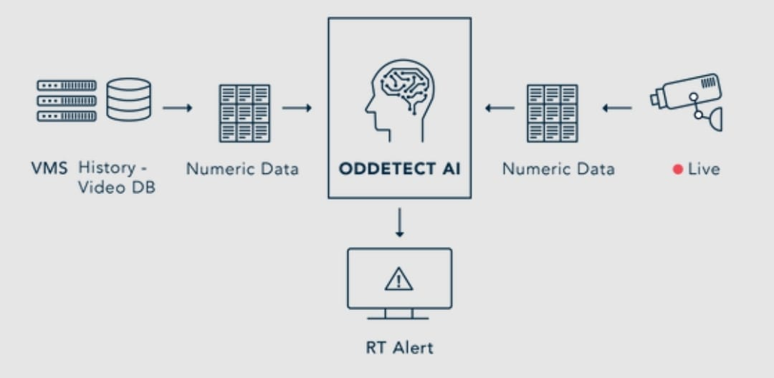
GitHub Repository Link & supporting diagrams, screenshots, if any
How far it can go?

Slide 9
Thank You
Team member names POORNISHA K
SRI NANDHINI R S
SOWNDHARIYA S
POORANI T
https://github.com/POORNISHAKATHIRVEL/poornisha.git

